Slide 1
Generation Data Group GDG
JCL Training Class - 03

Slide 2
Generation Data Groups(GDG)
A generation data group is a collection, or group, of cataloged data sets having the same name and related to one another. Each of these data sets is called a generation data set or ,simply, a generation.
Each generation data set is distinguished by others by the generation number.
The main advantage of using a GDG is that the same JCL can be reused without change.

Slide 3
Defining a GDG Base
IDCAMS is the utility program that performs functions vital to the virtual storage access method(VSAM).
The command format :-
    DEFINE GDG (PARMS).

Slide 4
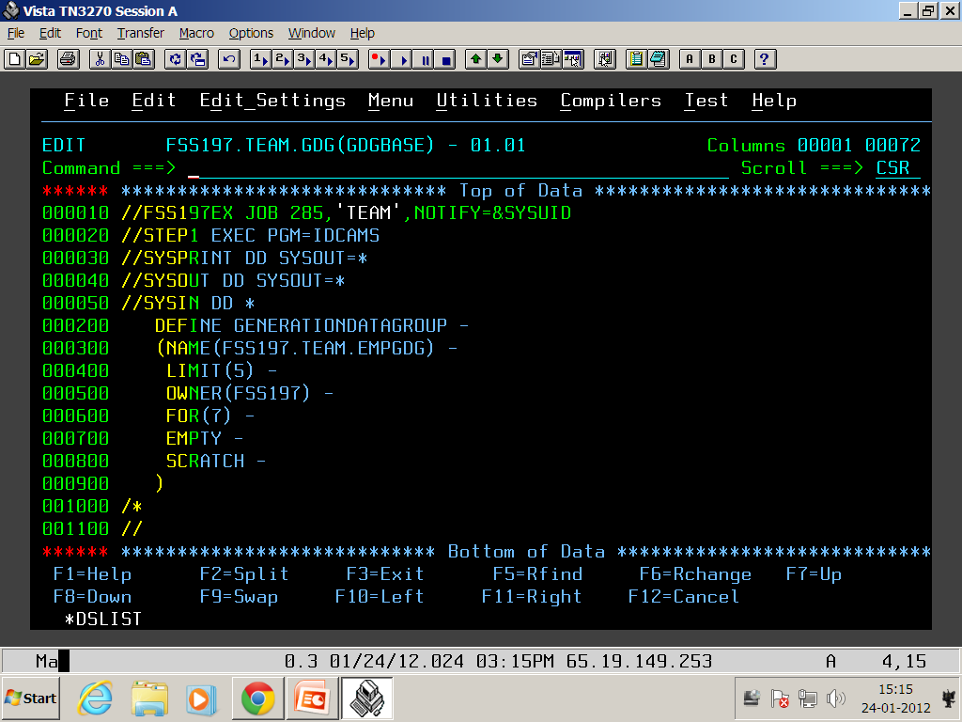
DEFINE GDG BASE

Slide 5
Define GDG parameters
Parameter | Meaning
NAME | GDG name.
LIMIT | The no. Of generations permitted for this GDG. The max is 255.
EMPTY | If empty is specified, all data sets are to be removed from the index when the limit is reached.
NOEMPTY | NOEMPTY is the default.
OWNER | User identification (optional).
SCRATCH | If scratch is specified,the dataset is scratched when the dataset is removed from the index.
NOSCRATCH | NOSCRATCH is the default.
TO (date) | Dataset retention period.
FOR(days) | Dataset retention period.

Slide 6
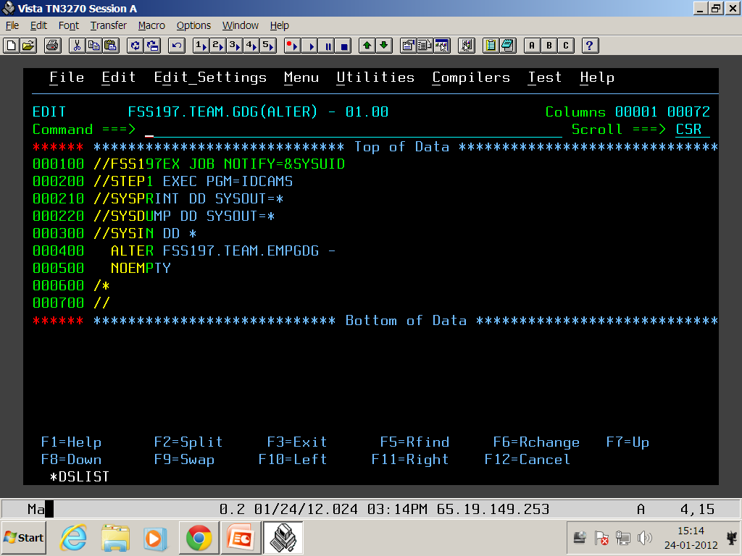
ALTER GDG BASE

Slide 7
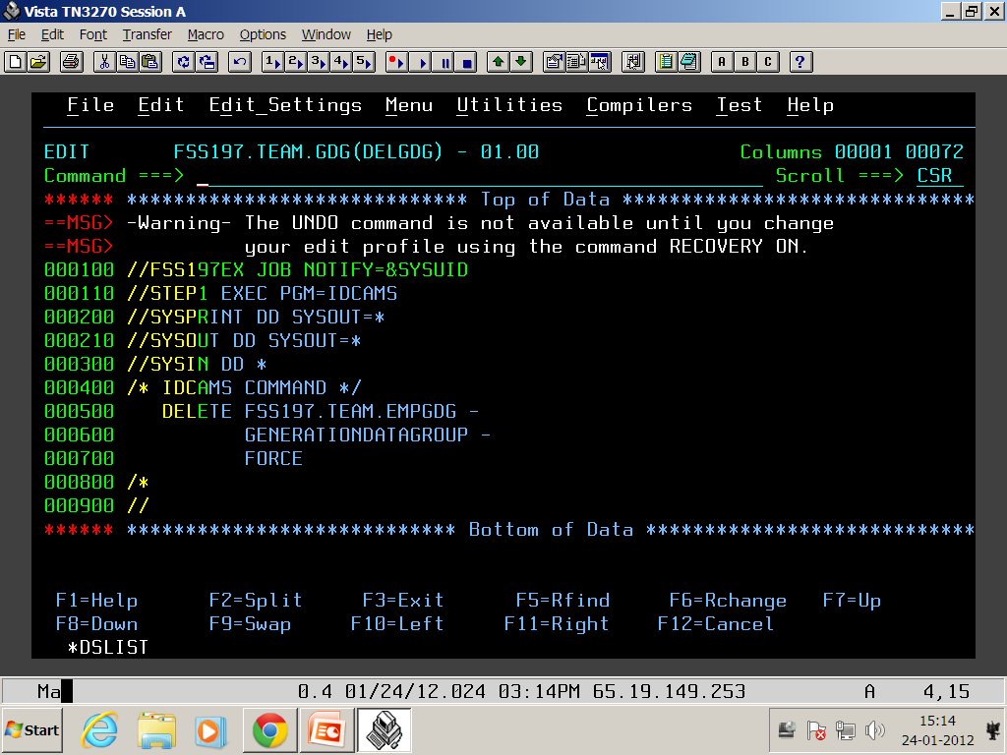
DELETE GDG BASE

Slide 8
PROCEDURES
Instream & catalog

Slide 9
Introduction to Procedures
A JCL Procedure is a pre-written segment of code, by which we can reuse the code of statements multiple times.
Procedure are of two types :
  INSTRAM PROC & CATLOG PROC
  Syntax for Executing procedure :
  //STEPNAME EXEC [PROC=] procedure-name

Slide 10
Instream procedure
In the instream procedure the set of code lies within the JOB and use it in that job as many times as you want.
Instream procedure should be defined , before any EXEC statement
Instream procedure starts with PROC and ends with PEND statements
The maximum number of instream procedures you can have in any job is 15
        // JOB
        // PROC
        //STEP1
        //STEP2
        // PEND
        // EXEC PROCNAME

Slide 11
CATALOGED PROCEDURES
Pre-written segment of code (which is stored as an member of PDS), which we can use as many times as we want in any job in the system.
When we are executing CATALOGED PROCEDURE, we need to specify where it is by using JCLLIB statement , if not it will search for the procedure in system procedure library SYS1.PROCLIB
FSS197.TEAM.PROC FSS197.TEAM.JCL
//PROCNAME PROC // JOB
//STEP1 // JCLLIB ORDER=FSS197.TEAM.PROC
//STEP2 // EXEC PROC NAME

Slide 12
Overriding
There are times, when we want to change procedure statements according to our requirement. There are three types of modification we can do ,
        Symbolic overriding
        Parameter overriding
        DD statement overriding
SYMBOLIC PARAMETERS : Usually, the same JCL can be used by different programmers to implement common tasks, such as the opening, reading, and writing of data sets. In those cases , we can use symbolic parameters. Using symbolic parameters we can pass value to a parameter which is used in procedure. A symbolic parameter on a DD statement is coded the parameter preceded by an ampersand.
Syntax
//[name] EXEC [PROC=]procedure-name,symbolic-parameter=value

Slide 13
Parameter overriding
Parameter overriding is used to add or modify step level parameters
Syntax : PARAMETER.STEPNAME= new value
PROCEDURE STATEMENT –
//STEP10 EXEC PGM=COBPROG,TIME=30 Parameter Override
//MYSTEP EXEC PROC=MYPROC,TIME.STEP10=40
//STEP10 EXEC PGM=COBPROG,TIME=30 Parameter Adding
//MYSTEP EXEC PROC=MYPROC,REGION.STEP10=56K
//STEP10 EXEC PGM=COBPROG,TIME=30
//MYSTEP EXEC PROC=MYPROC,TIME.STEP10= Don’t give any value for this
This will nullifying that parameter value in procedure .

Slide 14
DD statement overriding
on DD statement Syntax for add/modify DD statements in a procedure
  //name EXEC [PROC=]procedure-name
  //[PROCSTEPNAME].DDNAME DD parameter=value
  //
We can do following functions on EXEC statement in a procedure using above syntax
- Modify existing parameter on DD statements within a procedure
- Add parameter to existing DD statement within a procedure
- Add DD statement to a job step
- Nullify the effect of parameter on DD statement in a procedure

Slide 15
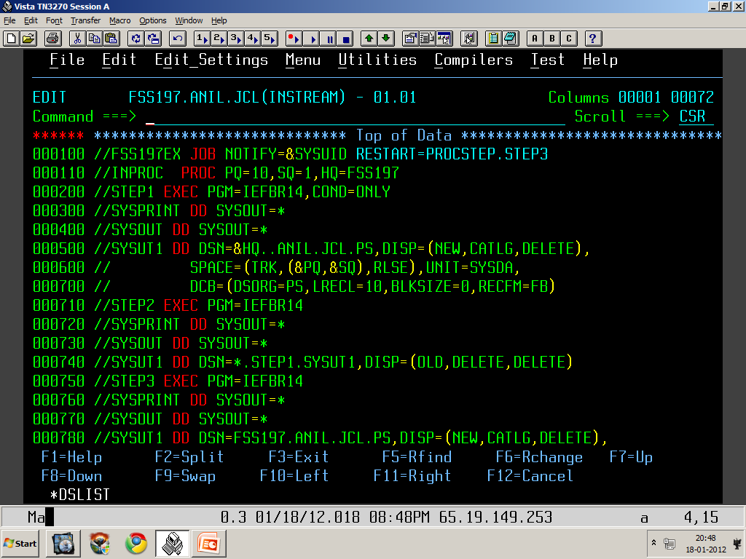


Slide 16
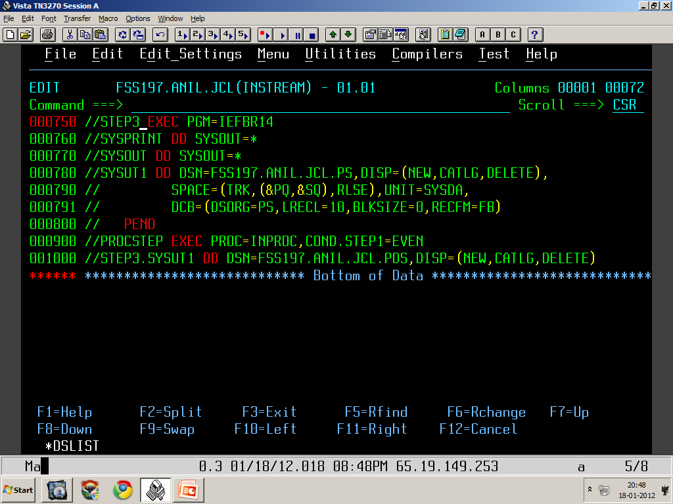

Slide 17
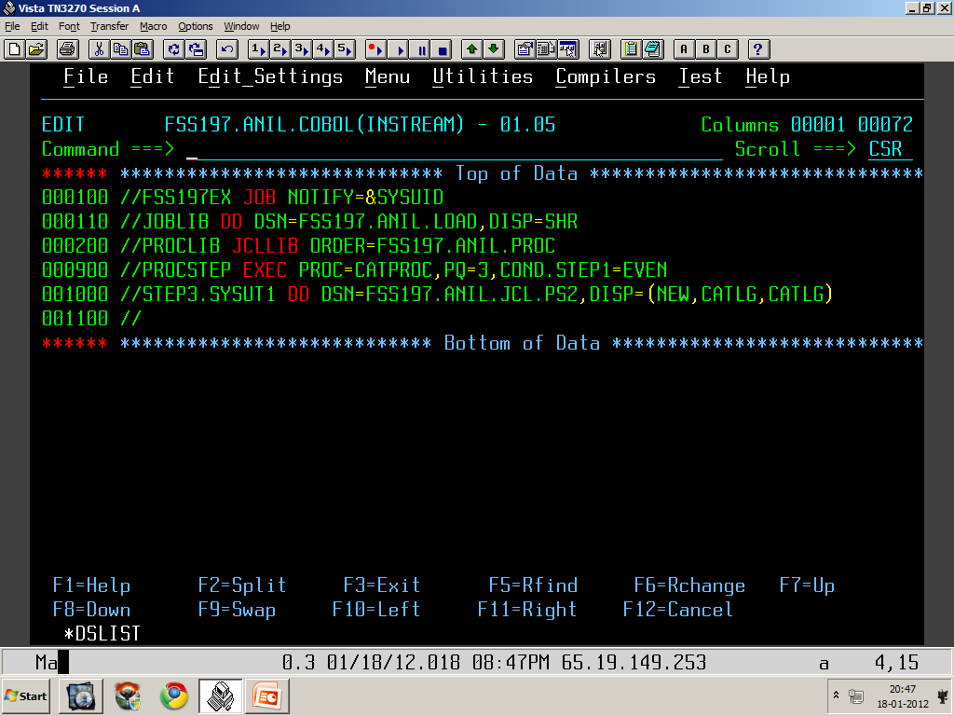

Slide 18
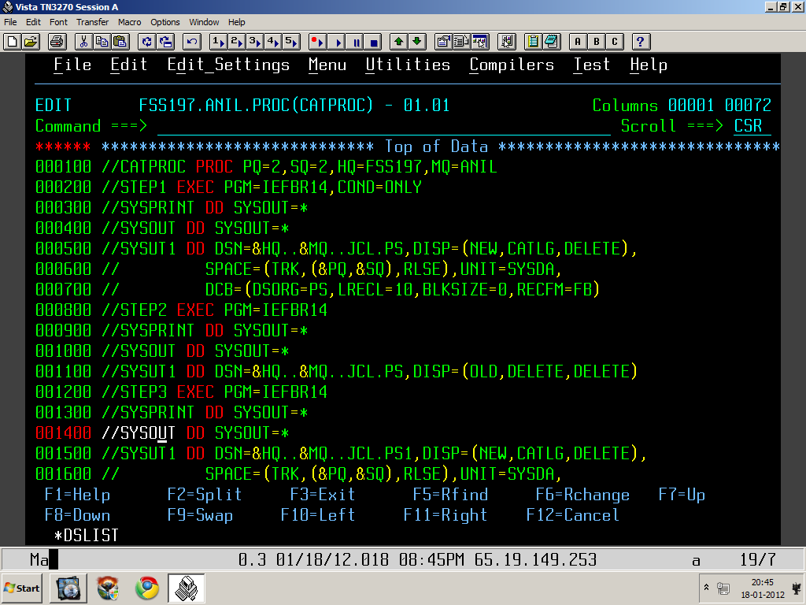

Slide 19
Thank You

